Slide 1
Joining Datasets Part 3

Slide 2
full_join() Function
Command Illustration
new_dataframe_name <- dataframe_1 %>%
full_join(dataframe_2, c("colname_1" = "colname_2"))

Slide 3
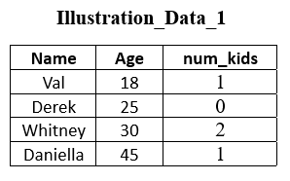
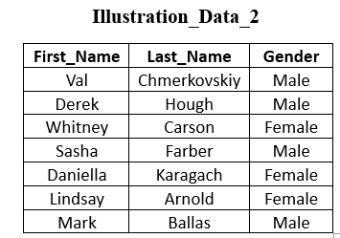

Slide 4
Example 1: Do a full join between Illustration_Data_1 & Illustration_Data_2.
example_1 <- Illustration_Data_1 %>%
full_join(Illustration_Data_2, by = c("Name" = "First_Name"))

Slide 5
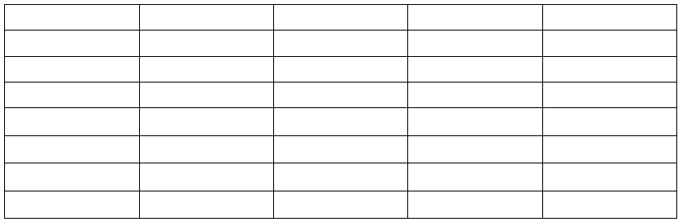
Output will be a dataframe that looks like:

Slide 6
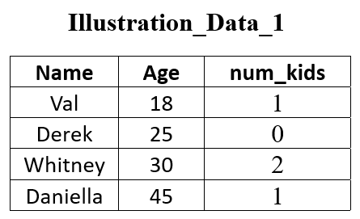
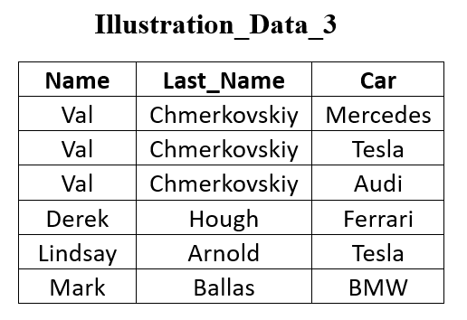

Slide 7
Example 2: Do a full join between Illustration_Data_1 & Illustration_Data_3.
example_2 <- Illustration_Data_1 %>%
full_join(Illustration_Data_3, by = c("First_Name" = "Name"))

Slide 8
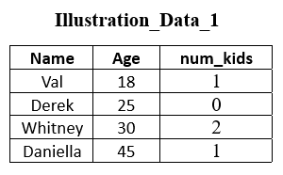
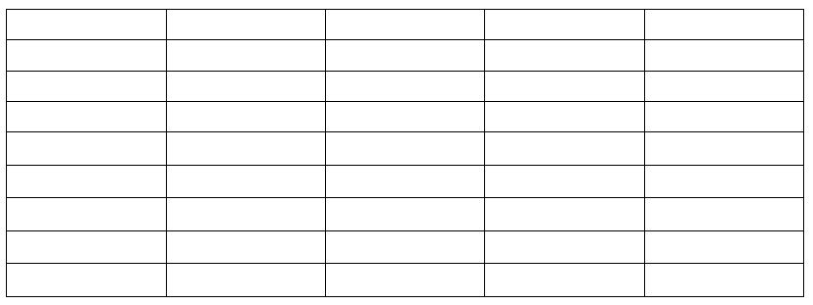
Output will be a dataframe that looks like:

Slide 9
Join by Multiply Columns
Command Illustration
new_dataframe <- name_dataframe_x %>%
inner_join(name_dataframe_y, by=c(“x1” = “y1” , “x2” = “y2”))

Slide 10
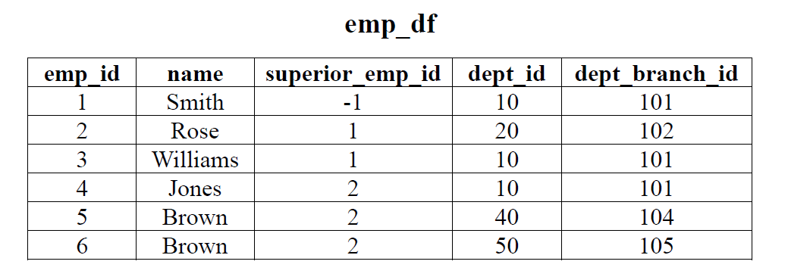
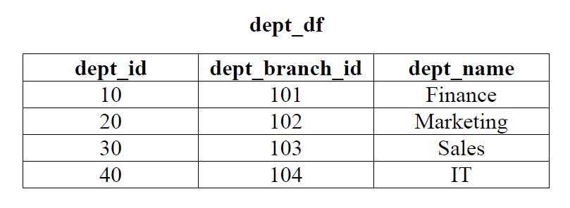

Slide 11
Example 3: Merge the following two dataframes (emp_df & dept_df) by “dept_id” & “dept_branch_id”.
example_3 <- emp_df %>%
inner_join(dept_df, by = c(“dept_id” = “dept_id”, “dept_branch_id” = “dept_branch_id”))

Slide 12
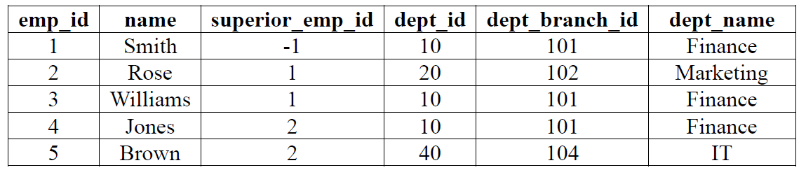
Output will be a dataframe that looks like:

